Slide 1
BCG-EdCast Product Enhancement Requests
FEBRUARy 2021

Slide 2
Agenda
Overview of enhancements and prioritisation
UI/UX
Authoring
Mobile
Integrations
Detailed requirements on select high prio items
U1: Inline-player for custom URLs
U2: Hide restricted SmartCards
M1: Make mobile app a true multi-tenant one
I1: Ability for bulk creation of pathways / journeys

Slide 3
Agenda
Overview of enhancements and prioritisation
UI/UX
Authoring
Mobile
Integrations
Detailed requirements on select high prio items
U1: Inline-player for custom URLs
U2: Hide restricted SmartCards
M1: Make mobile app a true multi-tenant one
I1: Ability for bulk creation of pathways / journeys

Slide 4
Enhancements: UI/UX (1 of 2)
GF 10.Mar.21: I feel U1 just became less important for us based on today's gov call (if we don’t want live learning app to be opened in iFrame). SCORM is not possible from Saba side in Iframe. What is actually left that we want to load in frame?
BB 09.Mrz.21: Overall, agree with P1 items = the ones we should push for in negotiations
No. | Description | Impact | Status | Priority
U1 | Inline player for custom URLs | Improve experience by eliminating need for users to click out to view content | Frank following up with Vinay based on 3/2 discussion. | P1
U2 | Hide restricted SmartCards | Customisation of journeys / pathways based on groups | Need to discuss with Vinay on product approach. Frank and Franz have further discussion. Two behaviors to address. 1 – hide card, 2 – account for progress if card not required. | P1
U3 | Enhanced UI design (see prototype) | More intuitive learner experience and navigation | Pietro provide discrete list of what is included in Picasso, and approx. timeframe | P1
U3a | Add group feature within a journey | Reduce navigation effort to get from journey to group | Partially met by current collaboration tools in SmartCard and Journey. Need to look at mockups, and comment on revision of communication in smartcards and journeys to support better threading. BCG has content attached at the chat level; this is not envisioned for EdCast. | P1
U3b | Remove continue button from journey | In current state, causes confusion between wording of button and actual behavior | Pietro provide discrete list of what is included in Picasso, and approx. timeframe | P4 [IN]
U3c | Extend cover image on Journey & channel page to full width | Reduce appearance of empty space on page | Pietro provide discrete list of what is included in Picasso, and approx. timeframe | P2 [IN]
U3d | Change 'View more' text hyperlink in description to 'Launch' | Improve experience with clearer CTA and consistent language | Pietro provide discrete list of what is included in Picasso, and approx. timeframe | P2 [IN]
U4 | More options for text formatting, e.g. add images and icons inline | Helps learners to understand where to focus attention in the learning, what is 'good to know' vs 'need to know' | Pietro provide discrete list of what is included in Picasso, and approx. timeframe | P2
U5 | Remove 'Assigned by' field from journeys | Eliminate confusion about unknown authors | Not on our roadmap, this is required by a majority of EdCast customers. Process solution for BCG – Marios discuss with SC team | P3 [IN]
BB 09.Mrz.21: What do we mean here? The continue button in a journey takes you where you left off in the journey. To me that is expected behavior.
What I find more confusing is the always green arrow on a smartcard – no matter whether I've consumed the content or not. So, I need to hover over or open the card to see whether it is marked complete. Have different color per status would be helpful grey → green Should we add that separately as P2?

Slide 5
Enhancements: UI/UX (2 of 2)
BB 09.Mrz.21: I am wondering whether U6 should be P1 as this is essential the more we scale
No. | Description | Impact | Status | Priority
U6 | Enable sub-workspaces for different audience | Reduce visual noise and confusion, add focus on relevant learning, allow branding | Segmentation for different groups of users, Micro-org functionality. Architecture issue to support multiple orgs and branding. Target 2Q22. Need Mockup of BCG request to align our vision with BCG vision – Frank/Marios connect with Vinay, BCG provide mockups. | P2
U7 | Ability to add diagnostic assessment at start of journey | Customized content that learner sees based on assessed competency level | Roadmap, planning phase. Frank/Marios discussion with Vinay on timing. | P3
U8 | Display picture on Quiz and Poll smartcards | More consistent visual experience. Important to help distinguish live event smart cards (blocker to using currently because this is not available) | Pietro provide discrete list of what is included in Picasso, and approx. timeframe | P3
U9 | Make English default language so learner does not see 'unspecified' | Reduce confusing terminology/fields on learner view | Pietro provide discrete list of what is included in Picasso, and approx. timeframe | P4
U10 | Fix "View more" link in pathways and journeys | Eg: Don't show the "view more" link if there is only one more card (and there is actually still space) | Pietro provide discrete list of what is included in Picasso, and approx. timeframe | P2
U11 | Fix completion button and check mark | Check mark for completed as well as uncompleted items should look differently (green vs grey?). Similarly the "Mark as complete" button within the cards. | [TBD] | P1
U12 | Change browser tab title | At the moment it says "Home – lab". Need to change this to "Home – LAB" or similar. Support said it is not possible currently. | [TBD] | P3
VK 09.Mar.21: Is this accounted for in our existing mockups? @Shiva
GF 12.Mar.21: U11 is solved now – it was only a colour scheme issue!
GF 12.Mar.21: Added U12 – likely possible to solve with "self-made" method as well

Slide 6
Agenda
Overview of enhancements and prioritisation
UI/UX
Authoring
Mobile
Integrations
Detailed requirements on select high prio items
U1: Inline-player for custom URLs
U2: Hide restricted SmartCards
M1: Make mobile app a true multi-tenant one
I1: Ability for bulk creation of pathways / journeys

Slide 7
Enhancements: Authoring
No. | Description | Impact | Status | Priority
A1 | Export more engagement data/activities from Smartcards | Ability to understand impact/engagement of cards for learners | EdData capability. BCG says reporting discrepancies between EdData and EdGraph. BCG provide input on discrepancies to Marios. | P2
A2 | Ability to contain multiple pathways/cards within a Smartcard | Would reduce number of clicks for learner to navigate between pieces of content | Not on EdCast Roadmap. BCG create use case examples (Shiva). | P2
A3 | Ability to combine multiple content types (e.g. text and video) within a Smartcard | Reduce number of cards to click through by having all pertinent information contained within the relevant/consolidated card | Request of for enhanced ability to add text to video and upload smartcards as it is in other cards. Frank/Marios discuss with Vinay. | P3
A4 | Offer additional assessment types (e.g. drag and drop, multi-select) | Broader choice of assessments to best fit evaluation needs | Not on roadmap. Frank/Marios discuss with Vinay | P4
A5 | Ability to clone journeys, or even better: ability to export and import them | Efficient means to replicate journey structure including all elements without carrying over settings | Not on roadmap. Frank/Marios discuss with Vinay | P3
A6 | Ability to create custom content types or completely disable content type from displaying | Reduce/eliminate confusion in terminology | Disabling is currently supported | P4
A7 | Move duration setting from advanced to regular | Move to be more directly in authoring flow | Pietro provide discrete list of what is included in Picasso, and approx. timeframe | P4
BB 09.Mrz.21: Does that include copying journeys between instances (sandbox and production?)

Slide 8
Agenda
Overview of enhancements and prioritisation
UI/UX
Authoring
Mobile
Integrations
Detailed requirements on select high prio items
U1: Inline-player for custom URLs
U2: Hide restricted SmartCards
M1: Make mobile app a true multi-tenant one
I1: Ability for bulk creation of pathways / journeys

Slide 9
Enhancements: Mobile
No. | Description | Impact | Status | Priority
M1 | Make mobile app a true multi-tenant one | Reduce confusion by not requiring learners to enter instance name | Q1 release per Neil – Marios get status from Neil | P1
M2 | Enhance Dynamic Group Management | Needed to replicate Saba's audience type restrictions | Capability of group management in EdCast. Frank/Bhaskhar set up integration hub session to review with Franz. | P1
M3 | Add 'Required' tab on mobile view to bring in line with desktop (and for journey discovery) | Inconsistent terminology between desktop and mobile, learners may be confused about where to find required learning on mobile. | Ongoing effort for mobile/web parity – Marios get status from Neil | P2

Slide 10
Agenda
Overview of enhancements and prioritisation
UI/UX
Authoring
Mobile
Integrations
Detailed requirements on select high prio items
U1: Inline-player for custom URLs
U2: Hide restricted SmartCards
M1: Make mobile app a true multi-tenant one
I1: Ability for bulk creation of pathways / journeys

Slide 11
Enhancements: Integrations
No. | Description | Impact | Status | Priority
I1 | Ability for bulk creation of pathways / journeys | Enable content organization to be imported in-tact (eg Saba curricula) | Add to existing api capability? Frank/Marios address with Vinay/Bhaskar | P2

Slide 12
Agenda
Overview of enhancements and prioritisation
UI/UX
Authoring
Mobile
Integrations
Detailed requirements on select high prio items
U1: Inline-player for custom URLs
U2: Hide restricted SmartCards
M1: Make mobile app a true multi-tenant one
I1: Ability for bulk creation of pathways / journeys

Slide 13
Agenda
Overview of enhancements and prioritisation
UI/UX
Authoring
Mobile
Integrations
Detailed requirements on select high prio items
U1: Inline-player for custom URLs
U2: Hide restricted SmartCards
M1: Make mobile app a true multi-tenant one
I1: Ability for bulk creation of pathways / journeys

Slide 14
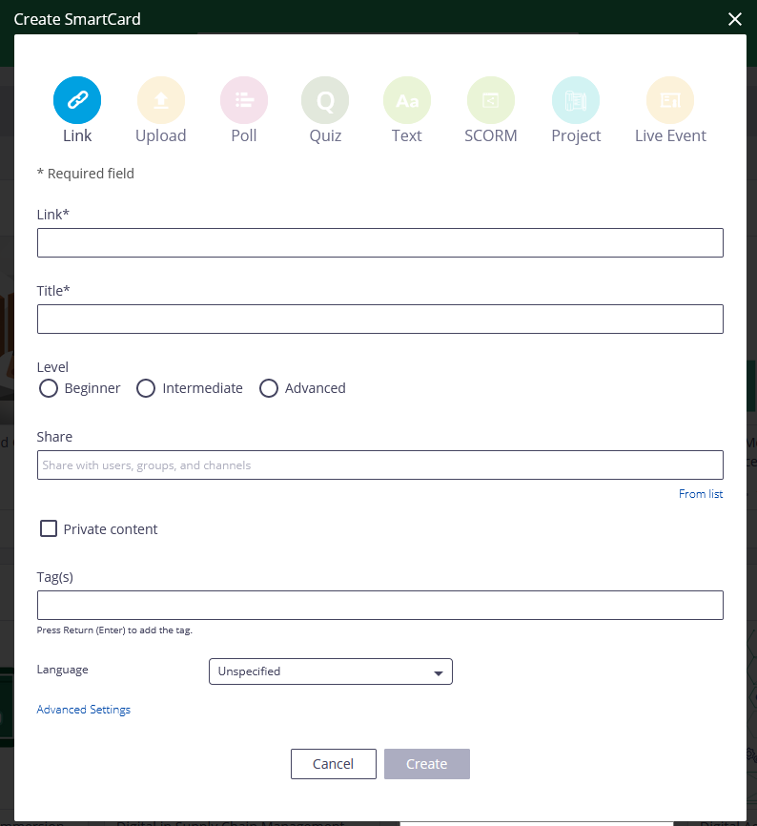
Specifications: Showing custom URLs as in-line content on EdCast
Configuration
Add option for "Link" SmartCards to open link in iframe (otherwise keep current experience)
Ideally offer variables in URL – such as [User_ID] and [User_Token] which get replaced when URL is opened
Add similar option for imported content (eg SFTP connector)
This will be a powerful option for all EdCast customers to include custom apps into EdCast! (In line with their "Netflix"/Aggregator idea)
Open link in-line:
On desktop
On mobile
X

Slide 15
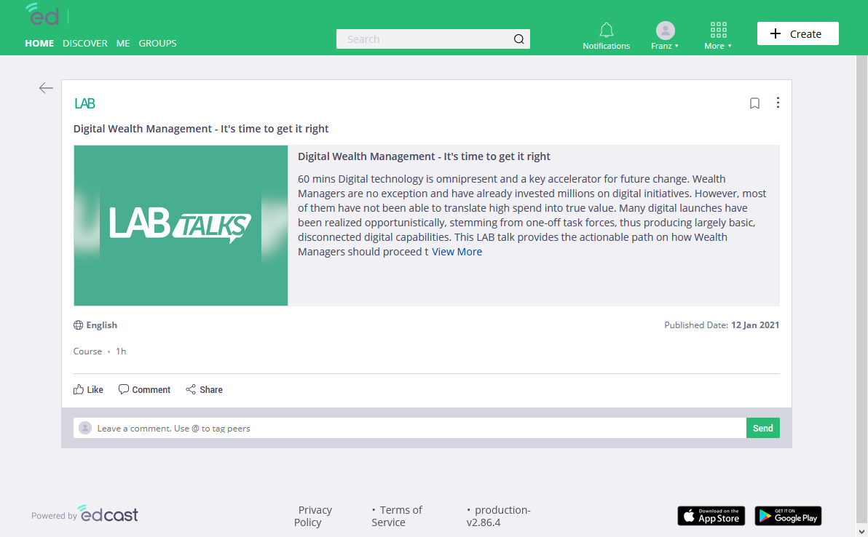
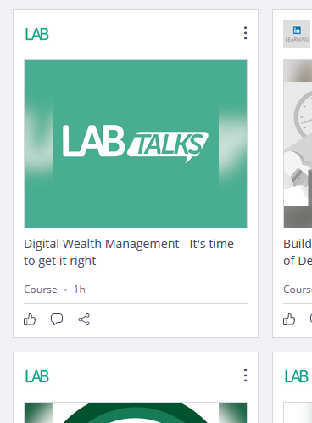
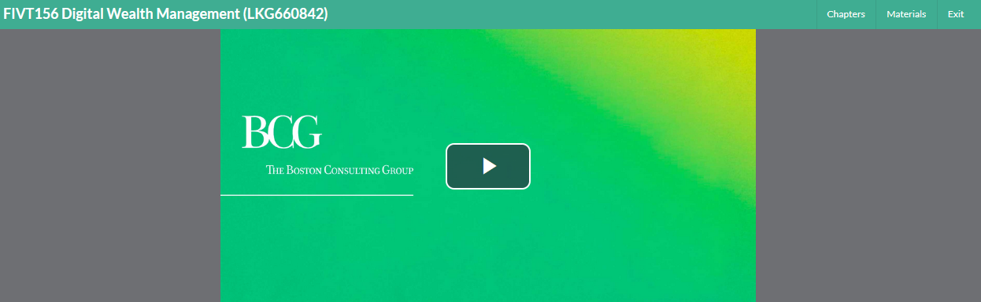
Example use case 1: Showing SCORM content as in-line player on EdCast
Add link/icon to open the iframe page as new window
Open in new window
Target experience:
Click on SmartCard directly opens the URL in an iframe (similar to uploaded PDFs at the moment)
Use case: SCORM content hosted on Saba should be displayed with in-line player on EdCast for seamless user experience

Slide 16
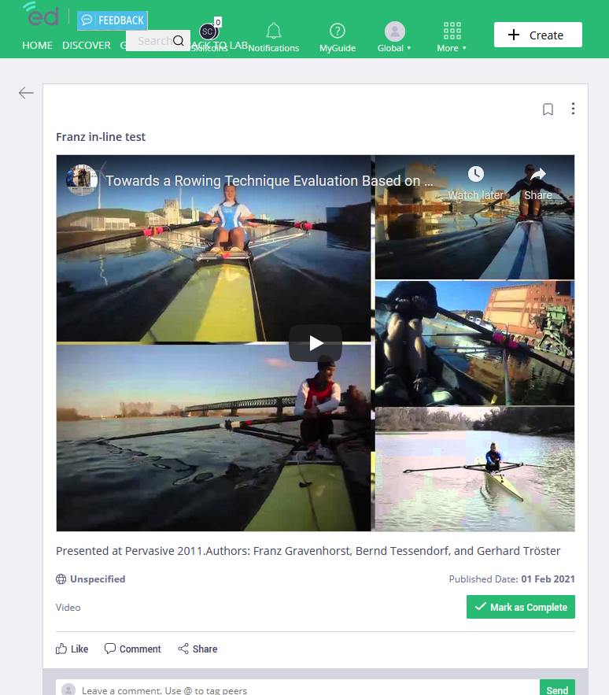
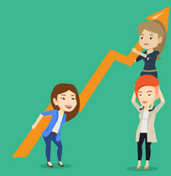
Example use case 2: Showing custom app in in-line player on EdCast
Advanced Excel Training
Open in new window
There are the following options available for you:
Monday 20/02/2021, 9am – 3pm
Wednesday 01/03/2021, 9am – 3pm
Friday 10/03/2021, 9am – 3pm
Register
Target experience:
Click on SmartCard opens a BCG app in an iframe in which user can select which session they want to register for
Advanced Excel Training
Register
Register

Slide 17
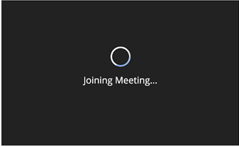
Example use case 3: Showing in-line zoom player on EdCast
Advanced Excel Training
Open in new window
Target experience:
Click on SmartCard opens a zoom player an iframe in whichuesr can attend live stream
Advanced Excel Training
Example zoom links see here: https://devforum.zoom.us/t/embed-zoom-video-to-a-web-server/2882/26

Slide 18
Agenda
Overview of enhancements and prioritisation
UI/UX
Authoring
Mobile
Integrations
Detailed requirements on select high prio items
U1: Inline-player for custom URLs
U2: Hide restricted SmartCards
M1: Make mobile app a true multi-tenant one
I1: Ability for bulk creation of pathways / journeys

Slide 19
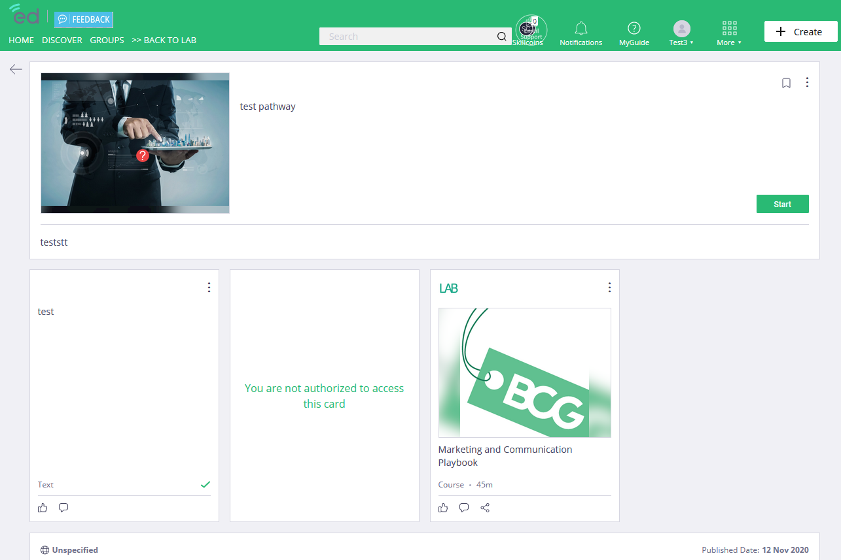
SmartCards that are not accessible for user should be hidden instead of showing error message [for pathways and journeys]
We want to hide these cards instead of showing the "no access" message.
And they should also not be considered in the journey's progress bar.

Slide 20
Agenda
Overview of enhancements and prioritisation
UI/UX
Authoring
Mobile
Integrations
Detailed requirements on select high prio items
U1: Inline-player for custom URLs
U2: Hide restricted SmartCards
M1: Make mobile app a true multi-tenant one
I1: Ability for bulk creation of pathways / journeys

Slide 21

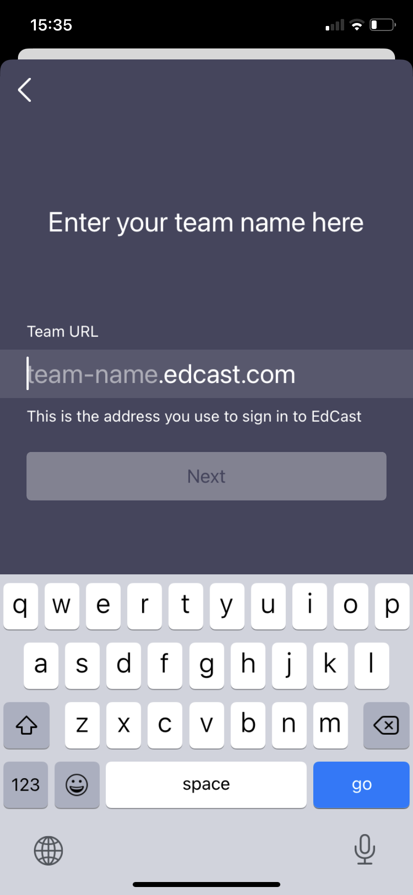
Still missing: option to pre-configure instance URL through MDM
Description
EdCast app is distributed through MDM solution to BCG employees
Currently, BCG employees still have to type in instance name when they log in for the first time
This instance name should be pre-configured when distributed through MDM solution¹
1. It is industry standard (and Apple recommendation / best practice) for multi-tenant applications that certain variables can be pre-defined through MDM

Slide 22
Agenda
Overview of enhancements and prioritisation
UI/UX
Authoring
Mobile
Integrations
Detailed requirements on select high prio items
U1: Inline-player for custom URLs
U2: Hide restricted SmartCards
M1: Make mobile app a true multi-tenant one
I1: Ability for bulk creation of pathways / journeys

Slide 23
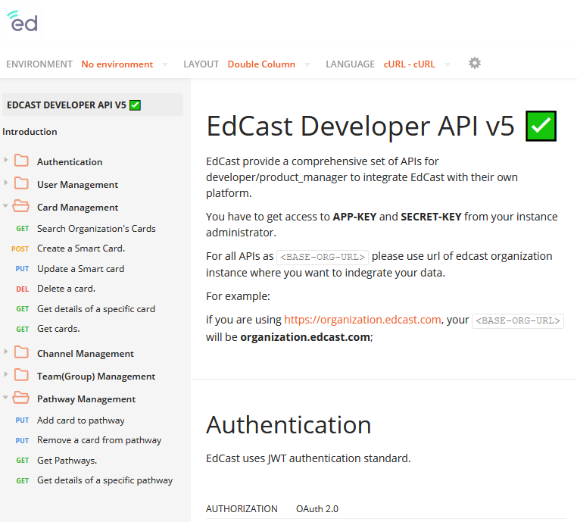
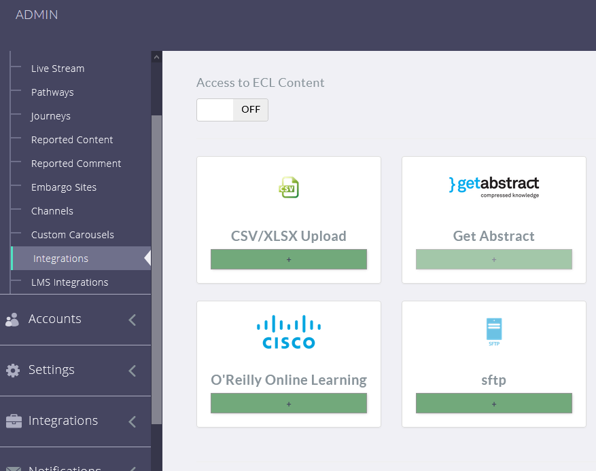
Still missing: Bulk creation of pathways/journeys on EdCast (through API or CSV upload)
Option 1: Extend EdCast developer API to allow creation of pathways
Option 2: Create function to upload CSV file to bulk create pathways
Similar to current CSV upload and SFTP connector for simple SmartCards – add same function for pathways
Current API allows creation of SmartCards…
… but it does not allow creation of pathways (or journeys)

